Slide 2
Noise Levels
Land Ownership
Location Options
System Dimensions

Slide 3
Noise Levels
Noise | dBa | Comparison
Garbage disposal, dishwasher, freight train at 15m, diesel truck 60km/h at 15m | 80 | 2 times as loud as 70 dB. Possible damage in 8 hour exposure.
Car at 80km/h at 8m (77 dB), freeway at 15m 10 a.m. (76 dB), radio or TV-audio, vacuum cleaner (70 dB). | 70 | Arbitrary base of comparison. Upper 70s are annoyingly loud to some people.
Conversation in restaurant, background music, Air conditioning unit at 30m. | 60 | Half as loud as 70 dB. Fairly quiet.
Quiet suburb, conversation at home. Large electrical transformers at 30m. | 50 | One-fourth as loud as 70 dB.
Library, bird calls (44 dB); lowest limit of urban ambient sound | 40 | One-eighth as loud as 70 dB.
Quiet rural area. | 30 | One-sixteenth as loud as 70 dB. Very Quiet.
Whisper, rustling leaves | 20
Breathing | 10 | Barely audible
Source: https://www.iacacoustics.com/blog-full/comparative-examples-of-noise-levels.html

Slide 4
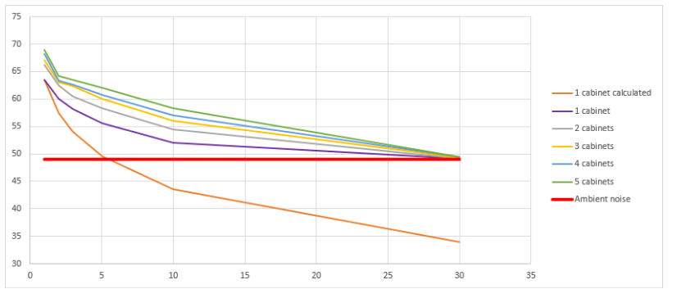
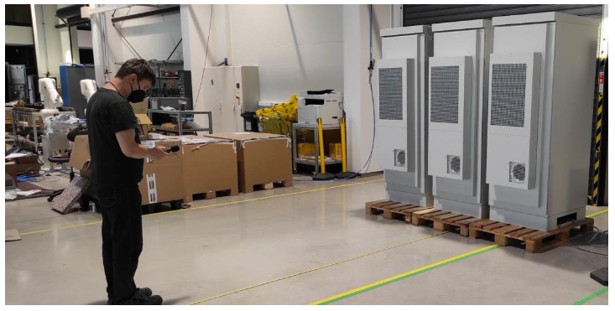
Noise Measurements
simulated actual site scenario with 5 systems
Source: Pixii Nov-21

Slide 5
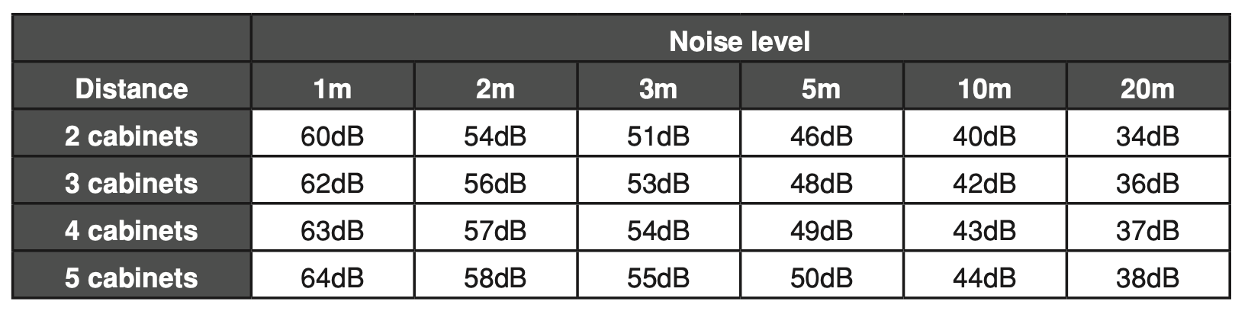
Noise Calculations

Slide 6
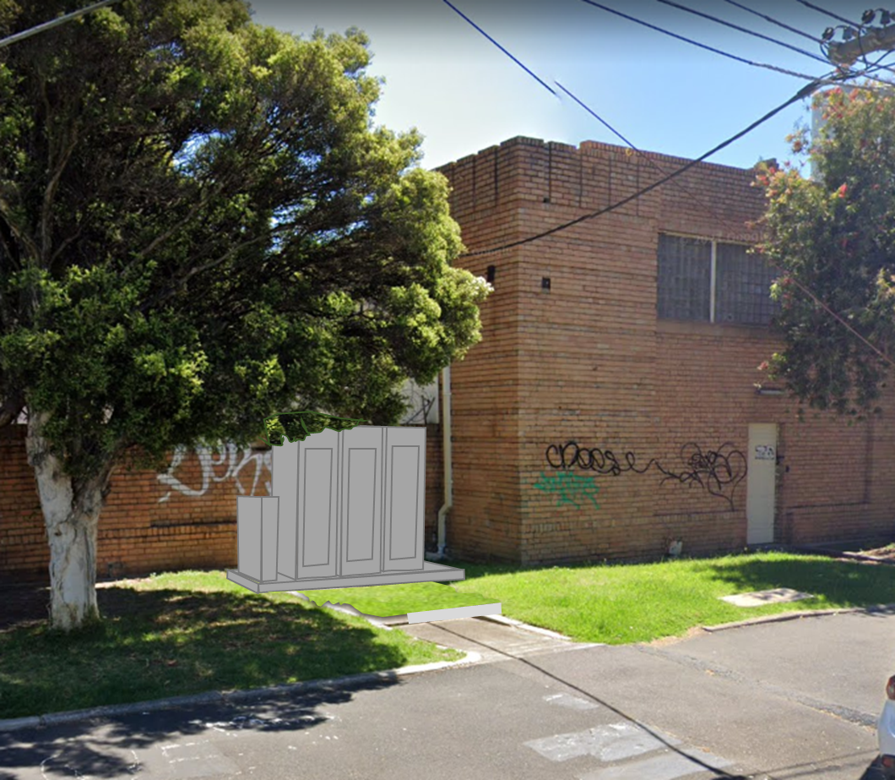
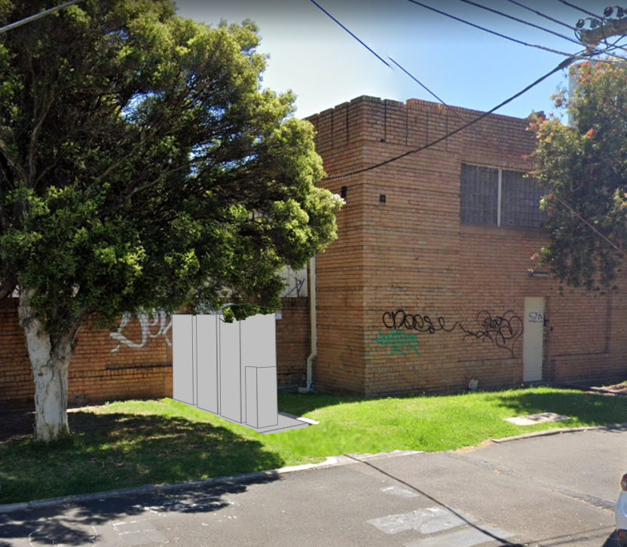
Michael St Options

Slide 7
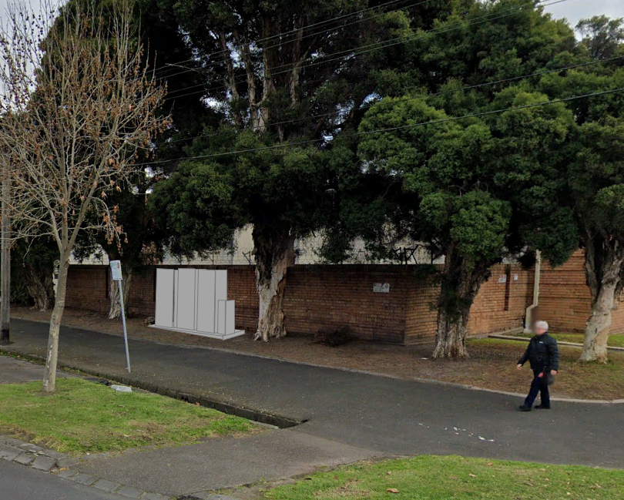
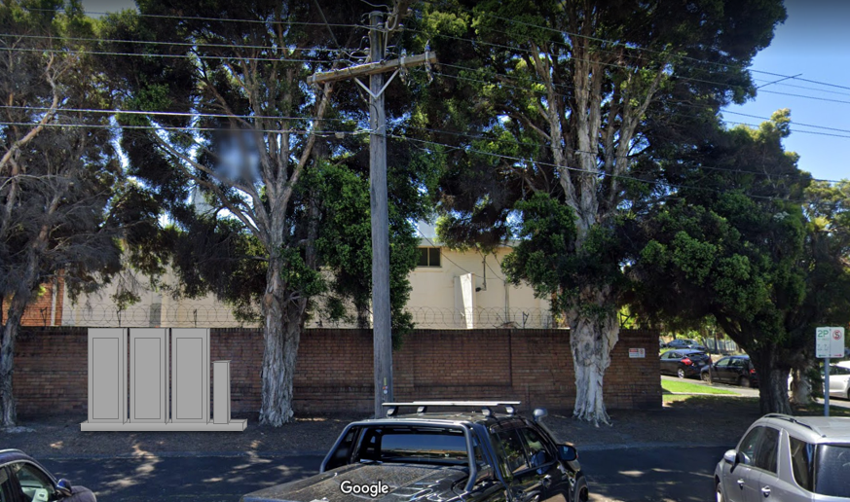
McKean St Option

Slide 8
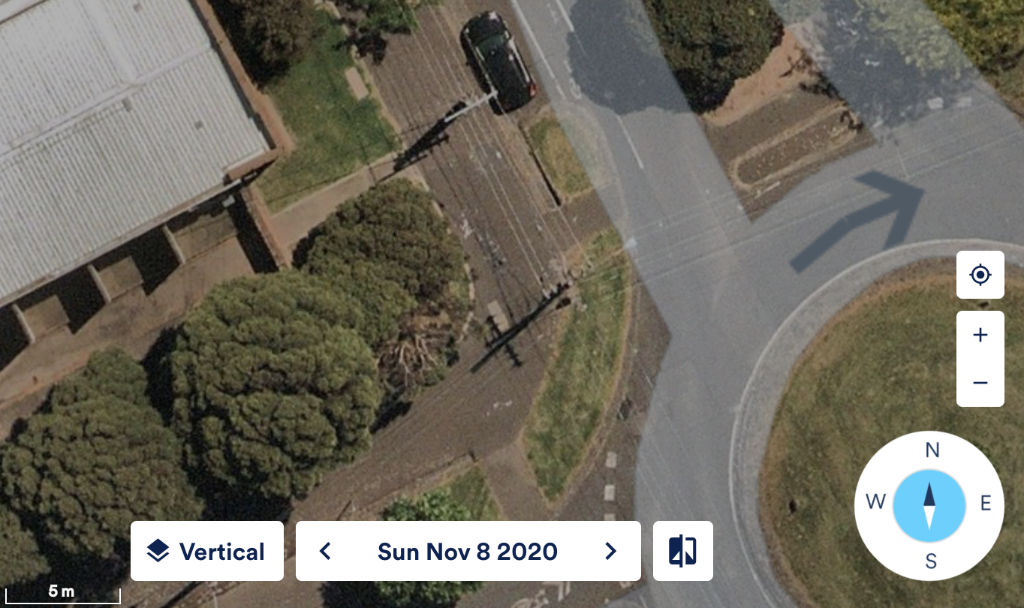
Proposed Location
Proposed location

Slide 9
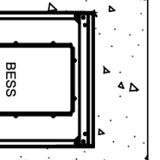
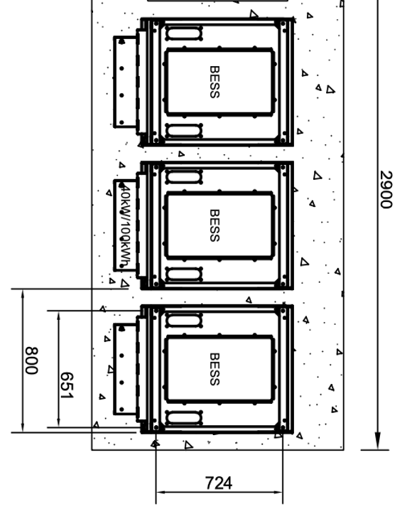

Proposed Location
Return
Meter & Marshalling Board
White
Tag
Wall
Wall
Cover
3200
Gate
1138
~2500

